Slide 1
Second Store
Andrés Rubio
Mursal Sheydayev

Slide 2
Contents
Organization
JSP
Testings
Code Coverage
API
Metrics
Website Design
Conclusions

Slide 3
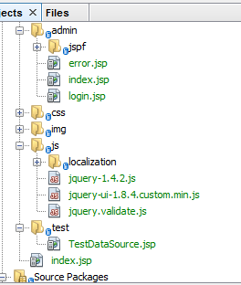
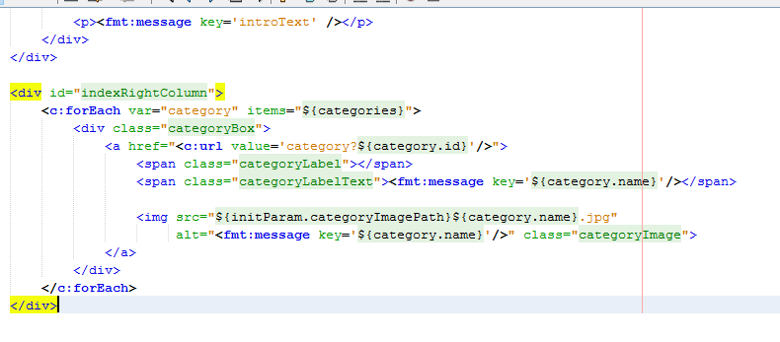
JSP

Slide 4
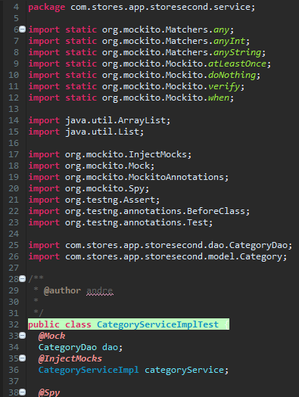
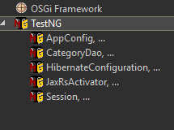
Testings

Slide 5
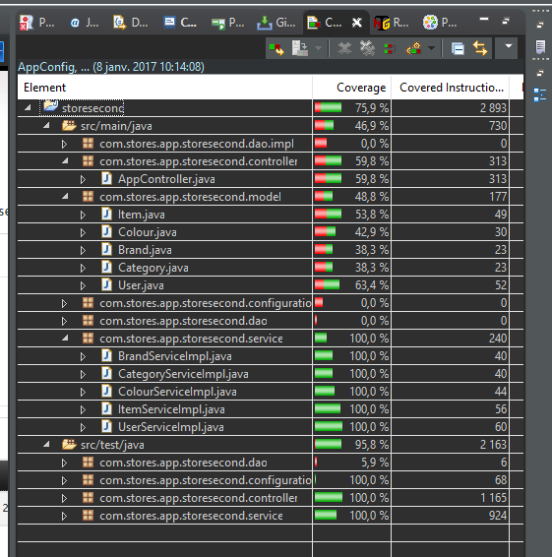
Coverage

Slide 6
API
public interface ItemsService {
Items findById(int id);
void saveItems(Items items);
void updateItems(Items items);
void deleteItemsById(String iditems);
List<Items> findAllItems();
Items findItemsById(String iditems);
boolean isItemsIdUnique(Integer id, String iditems);

Slide 7
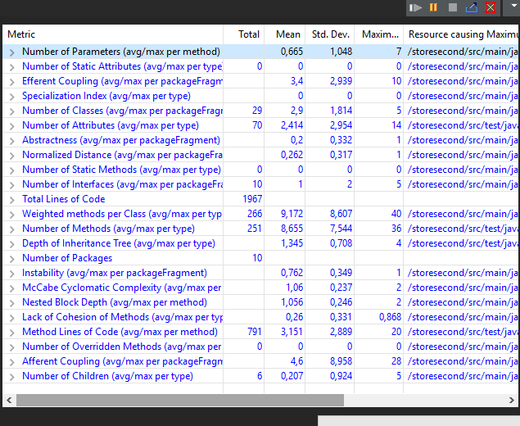
Metrics

Slide 8
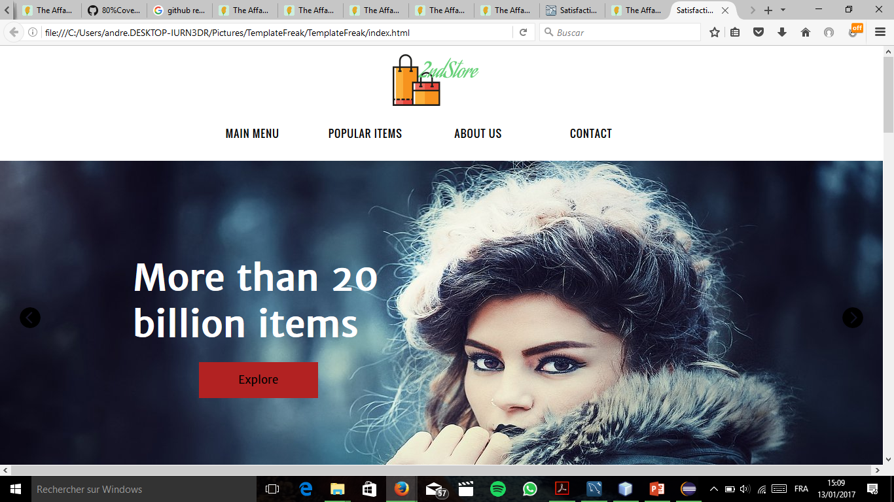
Website Design

Slide 9
Conclusions

